Slide 1
TITLE: INTEGRATED MACHINE LEARNING AND REINFORCEMENT LEARNING FRAMEWORK FOR RETAIL DEMAND FORECASTING AND INVENTORY DECISION OPTIMIZATION
Under the guidance of,
Mr.Ch.Poorna Venkata Srinivasa rao
Sr.Assistant professor
Presented By : Batch 40
23761A12A5 – Md Abdul azeez
23761A12D0 – V Vyshnavi
23761A12C5 – T Vardhan babu

Slide 2
OUTLINE
Abstract
Existing System
Proposed System
Results
Literature Survey
System Design
Implementation

Slide 3
ABSTRACT
  Retail businesses often face challenges in accurately forecasting product demand and maintaining optimal inventory levels, leading to stockouts or excess inventory. This project proposes an Integrated Machine Learning and Reinforcement Learning Framework for Retail Demand Forecasting and Inventory Decision Optimization. The system uses historical retail data to predict future demand using Machine Learning techniques and applies Reinforcement Learning to determine suitable inventory and replenishment decisions. The framework considers factors such as sales, inventory levels, pricing, discounts, promotions, weather conditions, and seasonality. By integrating demand prediction with intelligent inventory decision-making, the proposed system aims to reduce stockouts and excess inventory while improving overall inventory efficiency and supporting data-driven retail management.

Slide 4
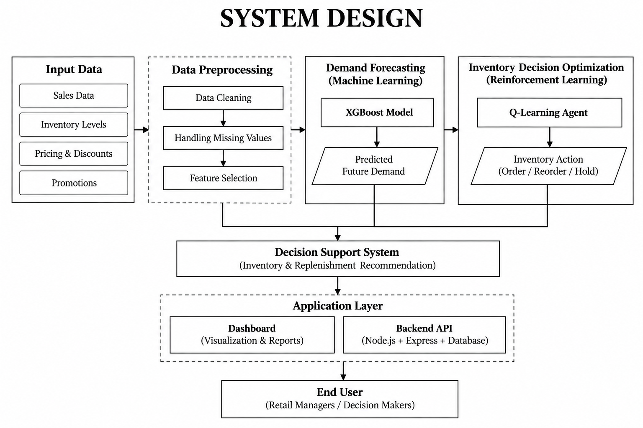

Slide 5
IMPLEMENTATION
Dataset Preprocessing: Collect and clean the retail dataset by handling missing values and preparing the required data for model training.
Feature Engineering: Extract relevant sales, inventory, pricing, and promotion features to improve demand prediction.
Demand Forecasting: Train the XGBoost model using historical retail data to predict future product demand.
Inventory Optimization: Apply Q-Learning to analyze predicted demand and current inventory for suitable inventory actions.
Model Integration: Integrate the XGBoost and Q-Learning models to generate intelligent inventory and replenishment recommendations.

Slide 6
LITERATURE SURVEY
Project Title | Year | Author(s) | Methods / Models Used | key Contribution
Neuroevolution Reinforcement Learning for Multi-Echelon Inventory Optimization with Delivery Options and Uncertain Discount | 2024 | Zakka Ugih Rizqi, Shuo-Yan Chou | Neuroevolution Reinforcement Learning (NERL), Artificial Neural Network (ANN), Evolutionary Algorithms | Optimizes inventory decisions under uncertain demand, lead time, discounts, and multiple delivery options.
IACPPO: A Deep Reinforcement Learning-Based Model for Warehouse Inventory Replenishment | 2024 | Ran Tian, Meng Lu, Haopeng Wang, Bo Wang, Qingxia Tang | GRU, Attention Mechanism, A2C, PPO | Combines A2C and PPO with GRU and attention to learn effective inventory replenishment strategies under changing demand conditions.
Data-Driven Dynamic Pricing and Inventory Management of an Omni-Channel Retailer in an Uncertain Demand Environment | 2024 | Shiyu Liu, Jun Wang, Rui Wang, Yue Zhang, Yanjie Song, Lining Xing | LSTM, Maskable PPO (ML-PPO), POMDP | Integrates future-demand prediction with PPO to optimize pricing, replenishment, and inventory-rationing decisions for an omni-channel retailer.

Slide 7
EXISTING SYSTEM
Traditional inventory methods may fail to accurately predict changing product demand.
Forecasting and inventory decisions are handled separately, making the overall process less efficient.
Static reorder rules may lead to overstocking or stockouts when demand changes unexpectedly.
Existing methods may not effectively consider sales, pricing, discounts, promotions, weather, and seasonality together.
They provide limited adaptability because inventory decisions are not continuously optimized based on changing conditions.

Slide 8
PROPOSED SYSTEM
ML-based demand forecasting predicts future product demand using multiple retail factors.
RL-based decision-making dynamically determines suitable inventory and reorder quantities.
Integrates ML and RL to connect demand prediction directly with inventory decisions.
Helps reduce stockouts and excess inventory by making data-driven replenishment decisions.
Provides a flexible and adaptive framework that can respond to changing demand and inventory conditions

Slide 9
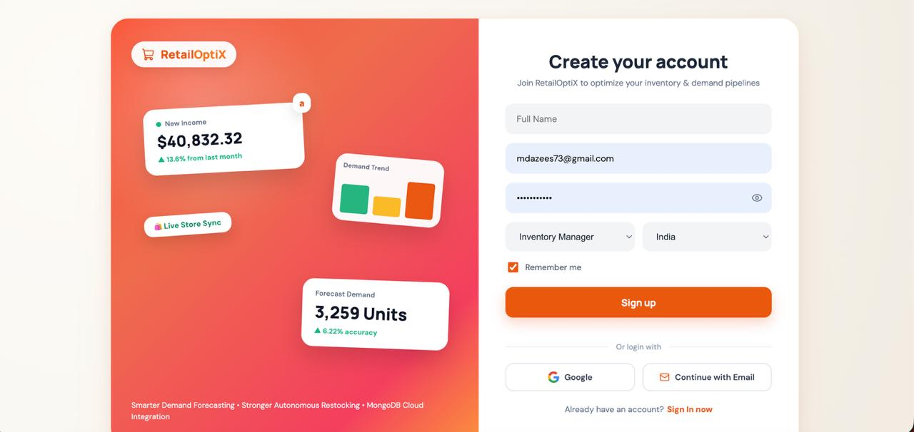
RESULTS

Slide 10
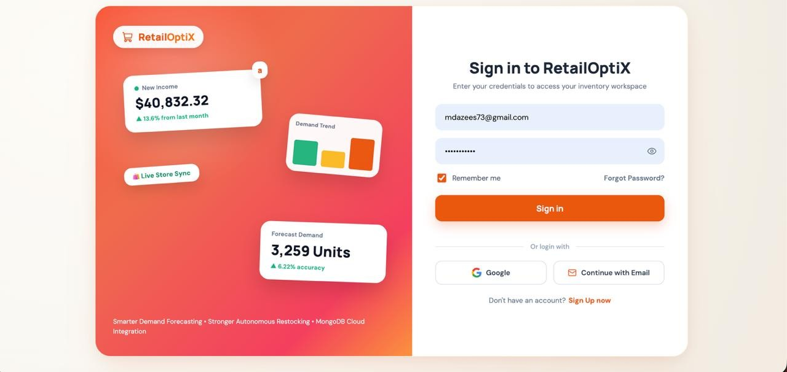

Slide 11
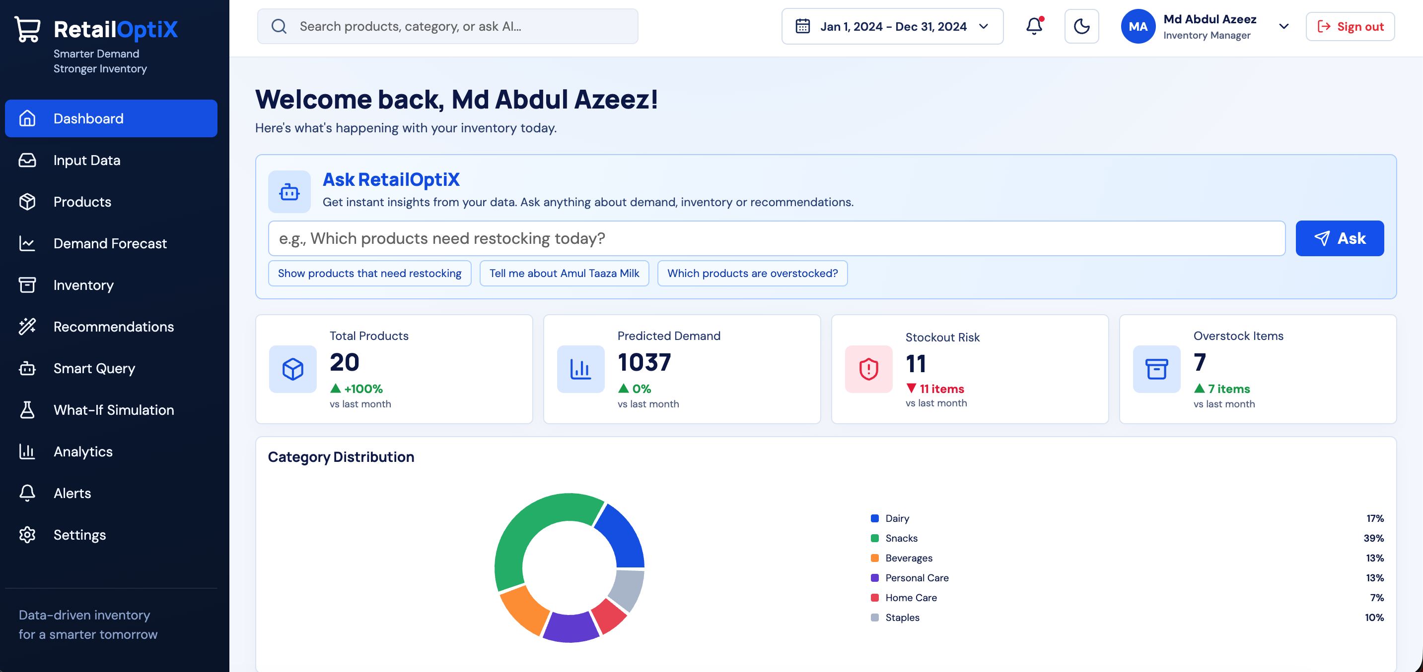

Slide 12
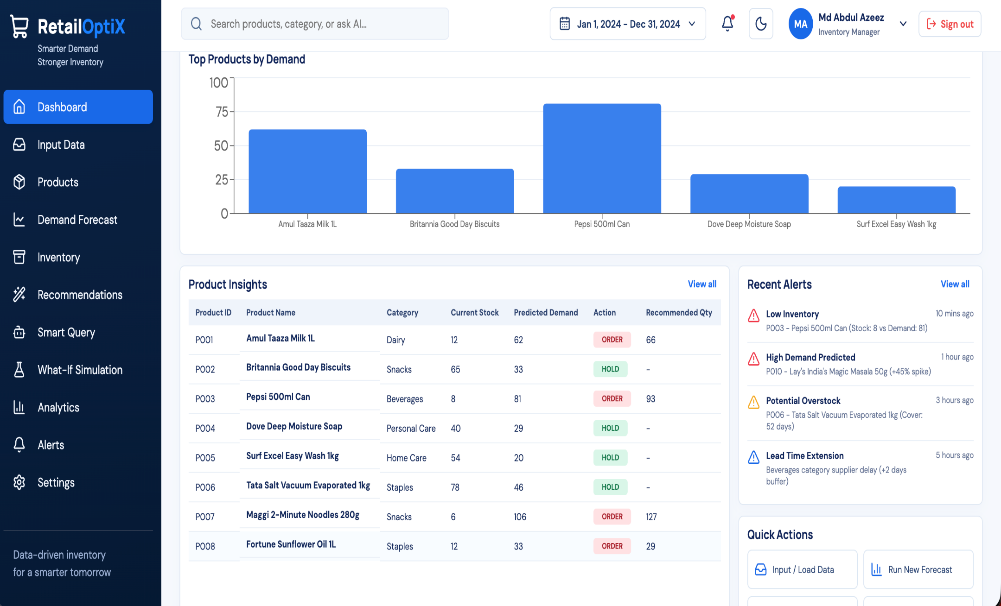

Slide 13
THANK YOU!

